Slide 1
Final Project –
Banoqabil CIT Course
Nimrah Shaikh| Al-huda campus 2-4 | Instructor ABDUL MUNIM USMANI

Slide 2
01
Microsoft Word - basic
04
Microsoft Excel – Intermediate
02
Microsoft word – advanced
Microsoft Excel – advanced
05
03
Microsoft Excel – basic
06
Microsoft PowerPoint
COURSE OUTLINE
Creating and formatting documents
Paragraphs, bulleting, line spacing, fonts
Inserting images, tables, headers/footers
Saving and exporting (PDF, Docx)
Charts and graphs (bar, pie, line)
Conditional formatting
Basic data validation and dropdowns
Styles and templates
Table of contents, references, and citations
Collaboration features in Google Docs
Page layout, section breaks, watermarking
Pivot tables introduction and creation
VLOOKUP and IF statements
Real-world data manipulation
Cells, rows, columns, formatting
Basic formulas: SUM, AVERAGE, MIN, MAX
Sorting and filtering data
Slide design and layout best practices
Inserting media, charts, and transitions
Animation techniques and timing

Slide 3
TABLE OF CONTENT
Resume & Formats Used
Spreadsheet & Formulas
01
03
Excel – Charts
Created charts for student records and budgeting sheet.
Applied fonts, bulleting, alignment, and exported as PDF.
02
04
Excel – Pivot Table
Summarized data into categories and highlighted totals.
Used SUM, AVERAGE, IF, VLOOKUP

Slide 4
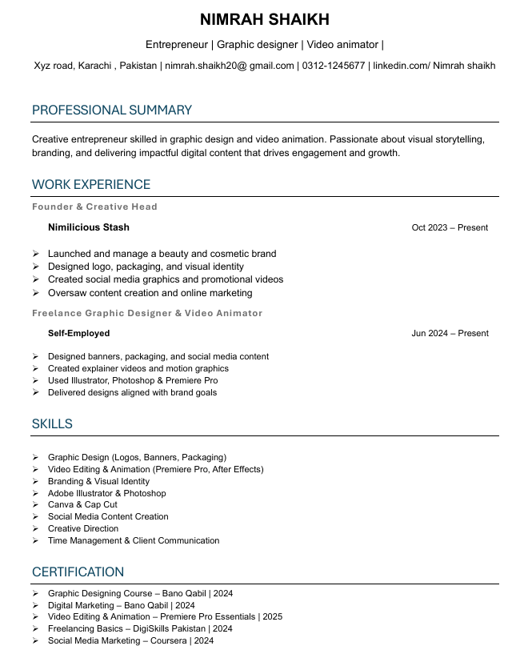
Resume(MS Word)
Applied font styles and bold headings for clear sections.
Used bullet points to list skills and experience.
Aligned text neatly for a professional look.
Exported resume as PDF.

Slide 5
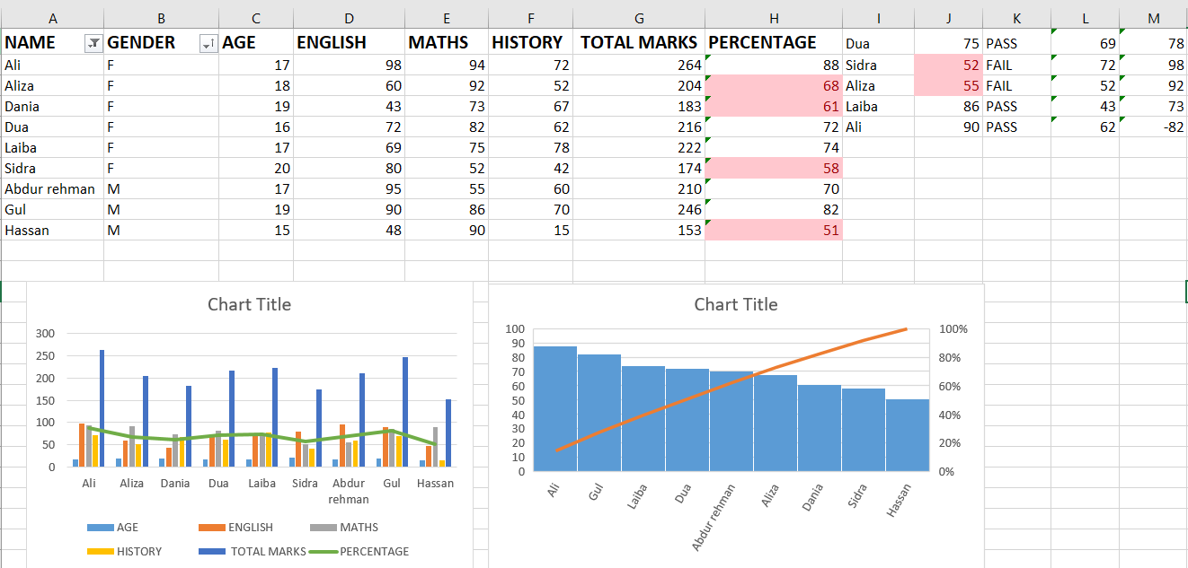
Excel – Formulas
formulas used:
=SUM(A1:A10) → Total
=AVERAGE(B1:B10) → Average
=IF(C2>50, "Pass", "Fail") → Logic check
=VLOOKUP(ID, Table, 2, FALSE) → Search values

Slide 6
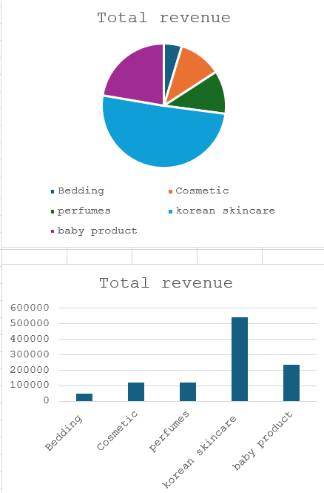
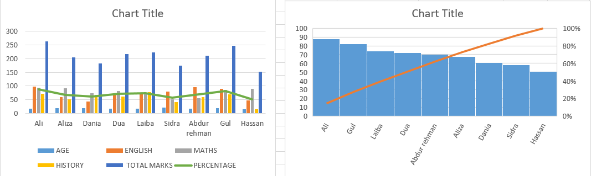
(Budgeting Sheet)
Excel – Charts
Created chart to track revenue
Helped in financial planning
(STUDENT RECORDS)
Visualized student marks with chart
Compared performance across students

Slide 7
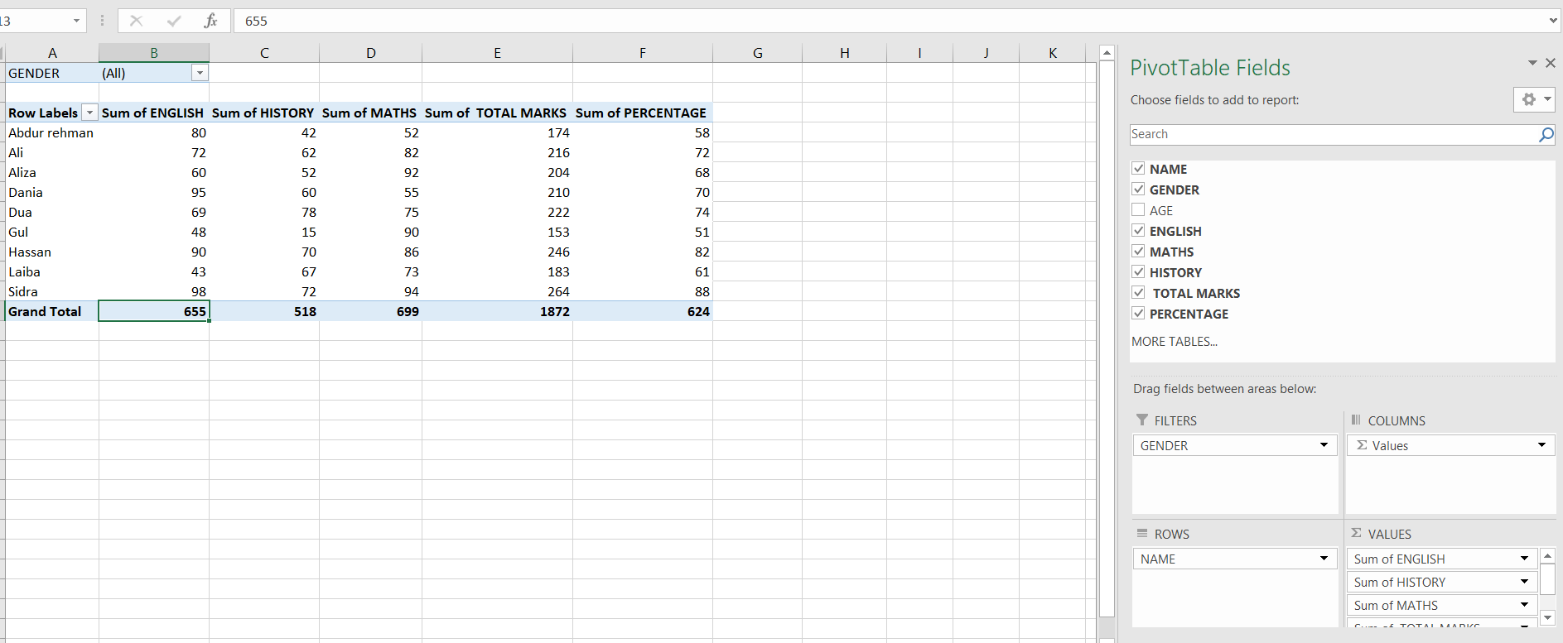
Excel – Pivot Table
Summarized dataset for quick insights
Highlighted totals and categories clearly

Slide 8
THANK YOU!

